Slide 1














Credit Risk Modelling
Of peer to peer lending
Bondora systems

Slide 2
Team 16
Name | Section | BN
Khaled Hesham | 1 | 21
Abdelaziz Salah
Abdelrahman Noaman
Kirollos Samy | 2 | 13

Slide 3
TABLE OF CONTENTS
01
02
Problem Statement
Project Pipeline
03
Analysis and Observations
04
Model Training and Evaluation
05
06
Unsuccessful trials & future work
Deploy On Azure

Slide 4
Problem Statement
01

Slide 5
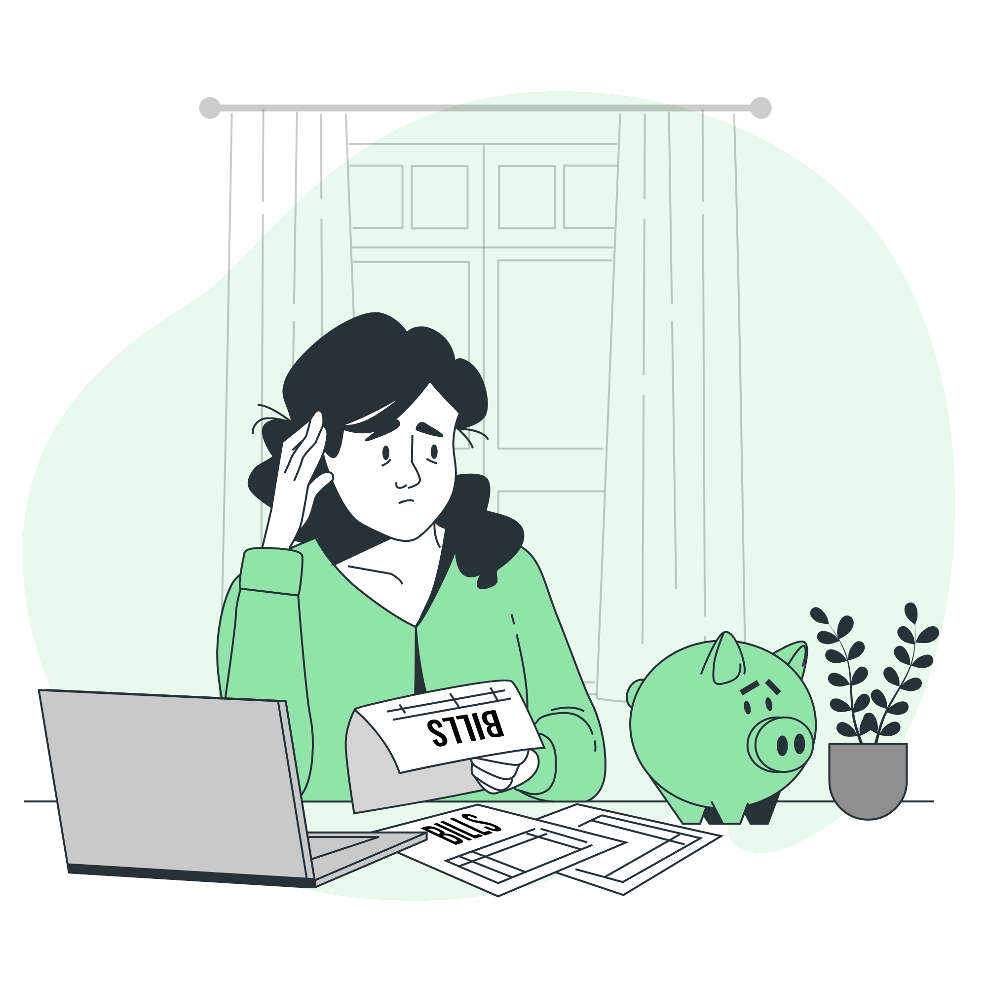
Developing a precise credit risk model for Bondora's peer-to-peer lending platform, leveraging borrower data to predict default likelihood, enabling informed investment decisions and risk management.

Slide 6
Project Pipeline
02

Slide 7
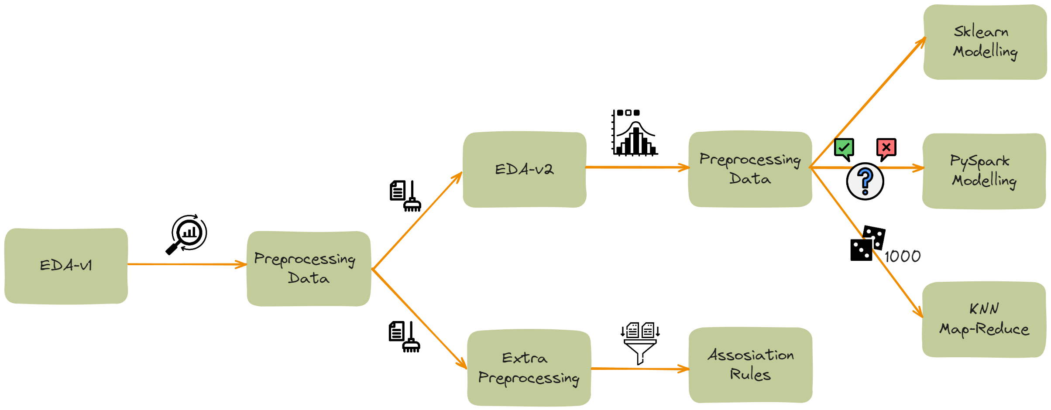

Slide 8
Analysis and Observations
03

Slide 9

EDA –V1 & preprocessing
removing columns having null values more than 40%
Remove all features that will have zero impact on default prediction like LoanId, LoanNumber
Create target variable (Current loan having default date else not defaulted)
Each feature is plotted with other to show correlation between them (confusion matrix later)
Distribution of categorical variables
Restore labels for better visualizations
Save the preprocessed data

Slide 10
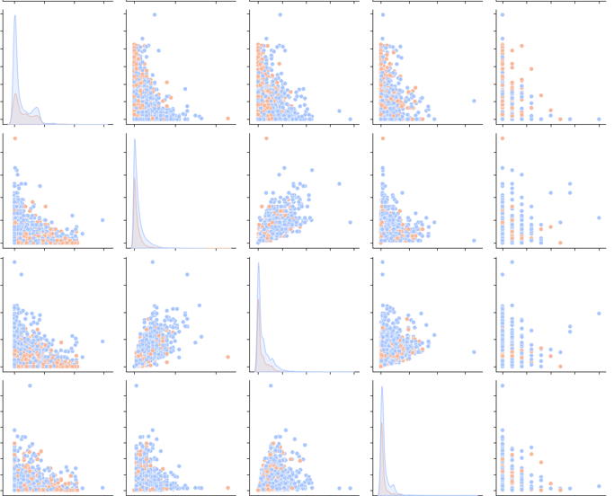
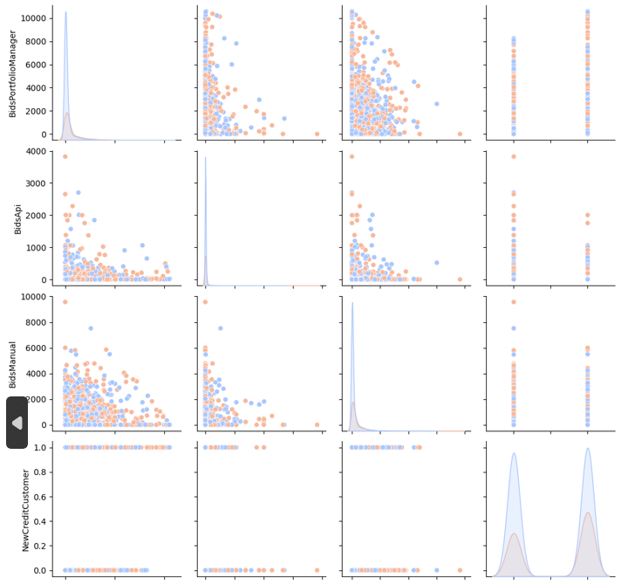
EDA –V1
Random snapshot of pair plot to show correlation of each feature with other

Slide 11
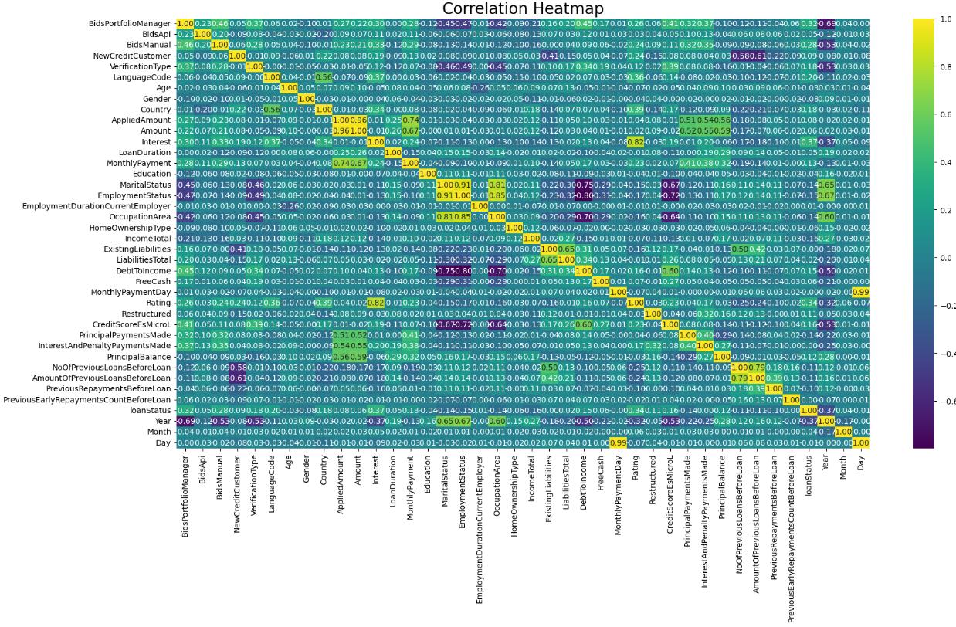
EDA –V2
most of data are not correlated so no columns to be dropped

Slide 12
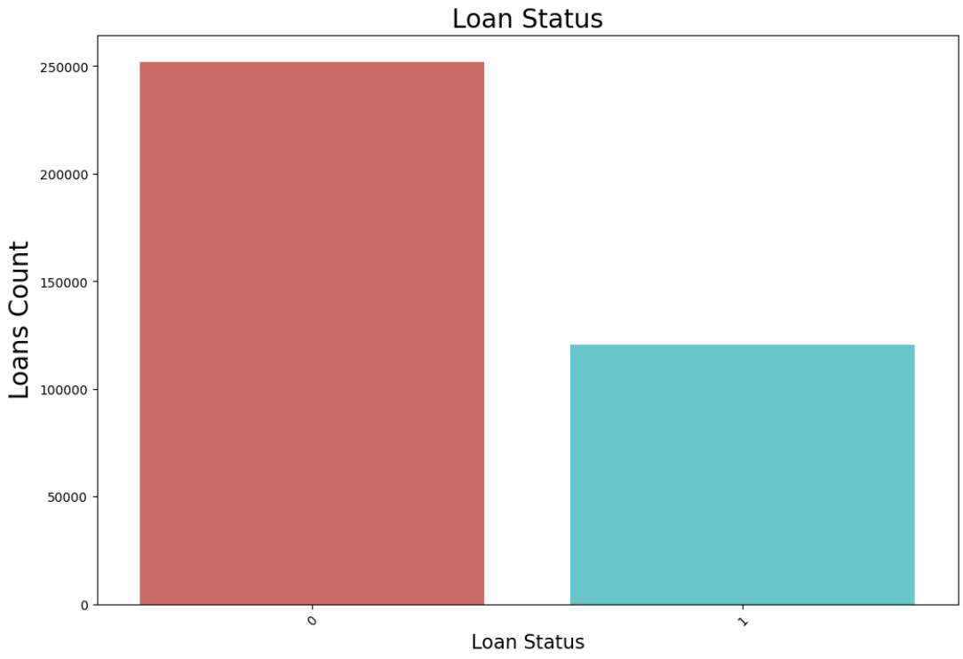
Target variable destribution

Slide 13
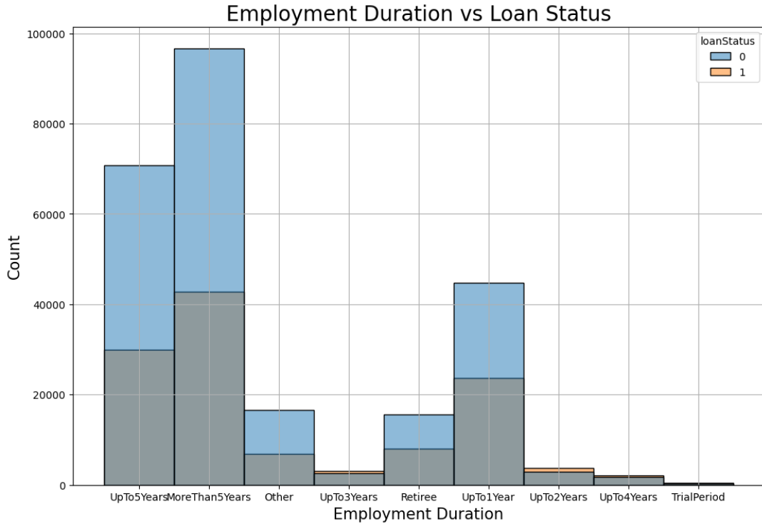
more than 5 years employment have high acceptance among all employee status but also highest loans rejected while employees up to 3 years, 2 years up to 4 years employment the loan is most likely be defaulted (rejected) → you need 5 years of experience to have high probability of your loan be accepted

Slide 14
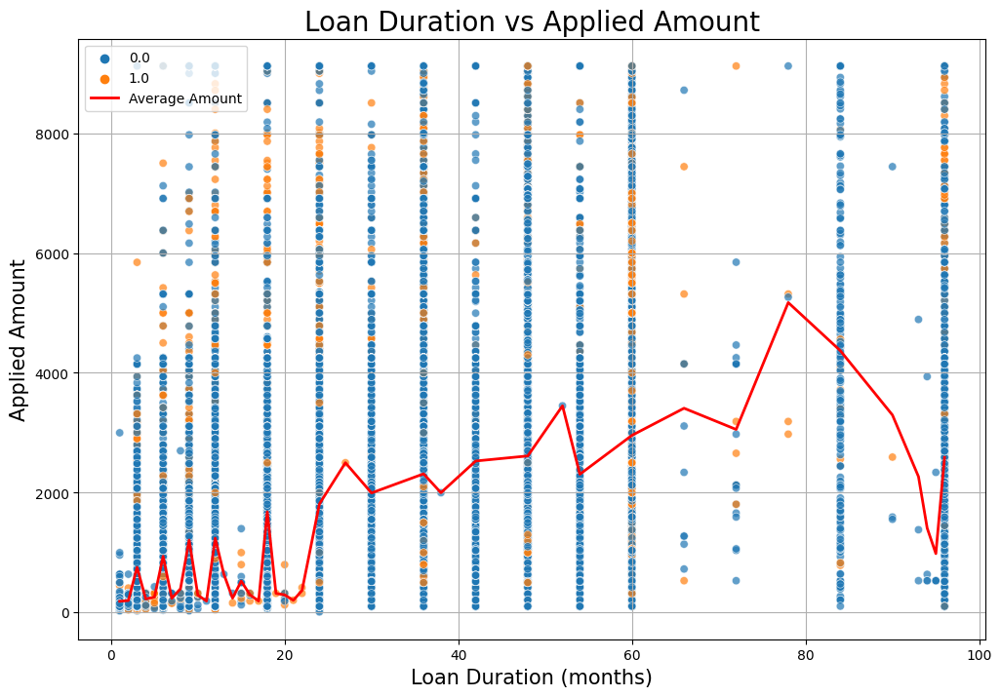
As Duration increases Applied amount also increases despite the fact that most loans are applied in the range 100-120 months

Slide 15
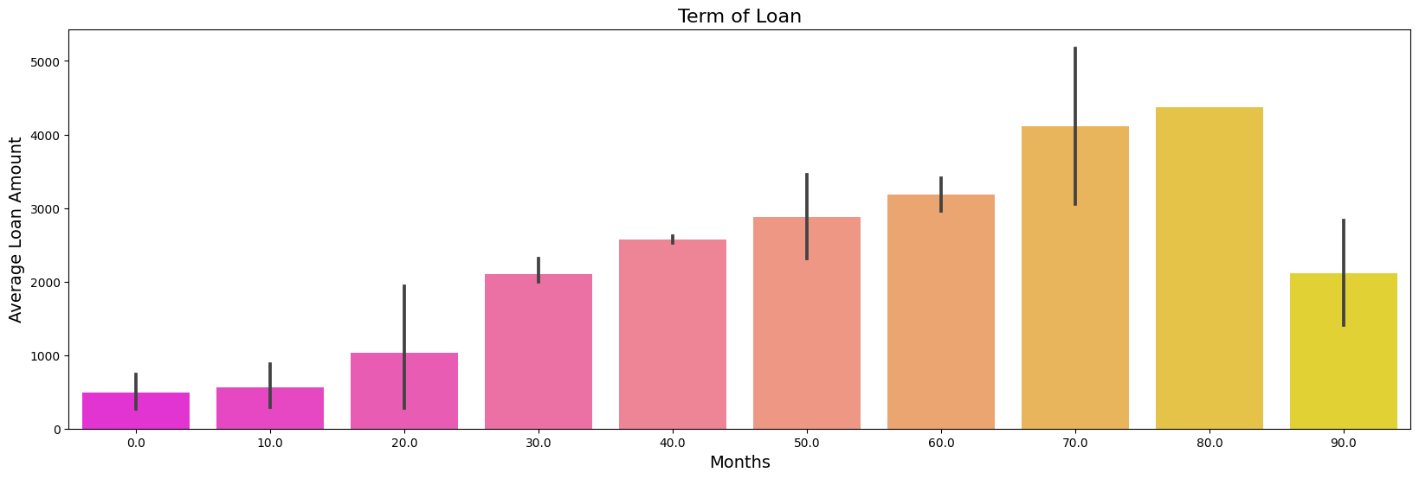
Large loan amounts are within range of 70-80 months duration

Slide 16
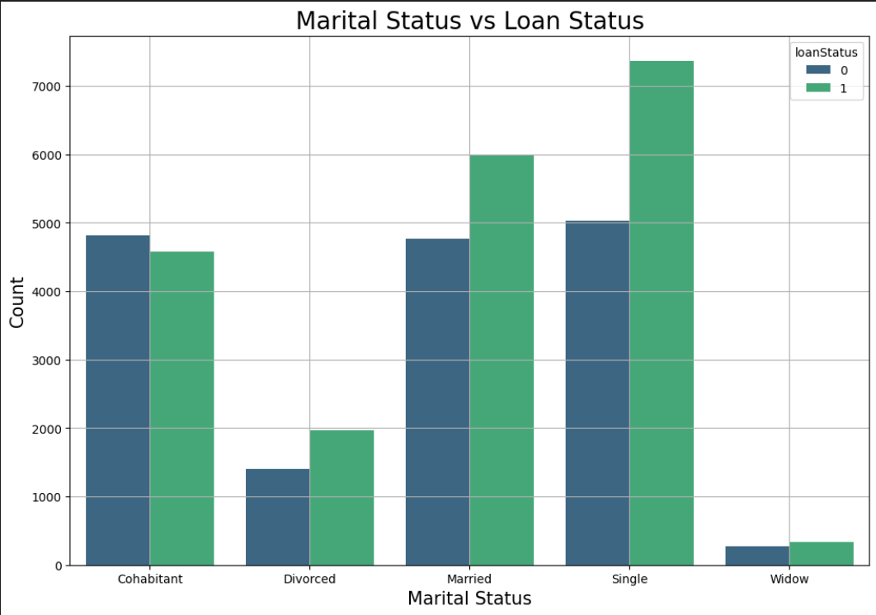
being single is more likely your loan will be rejected ☹

Slide 17
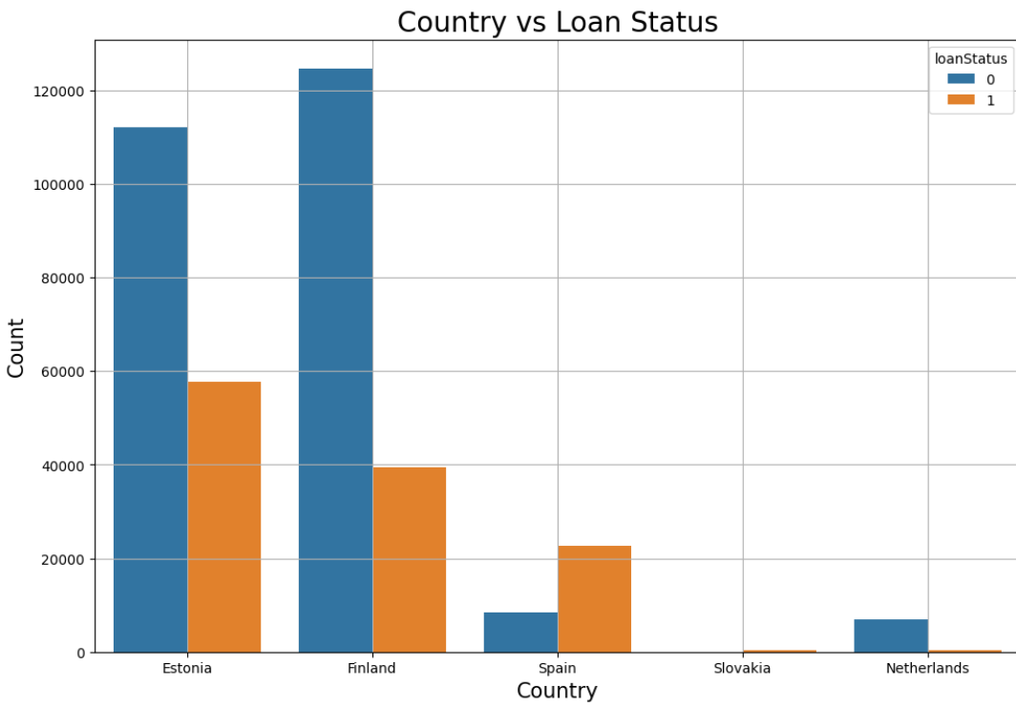
Most loans in Estonia and Finland are accepted while in Spain most loans are rejected

Slide 18
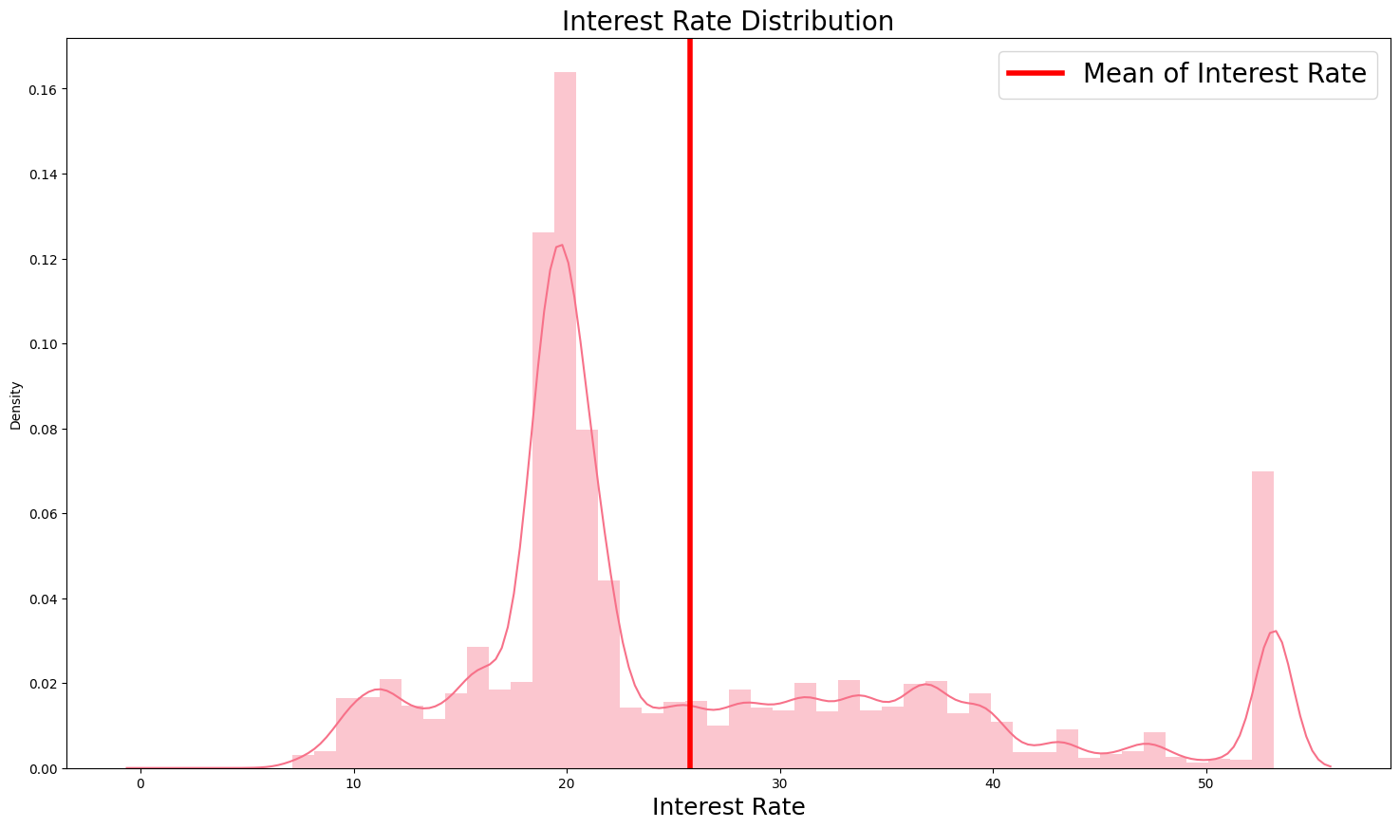

Slide 19
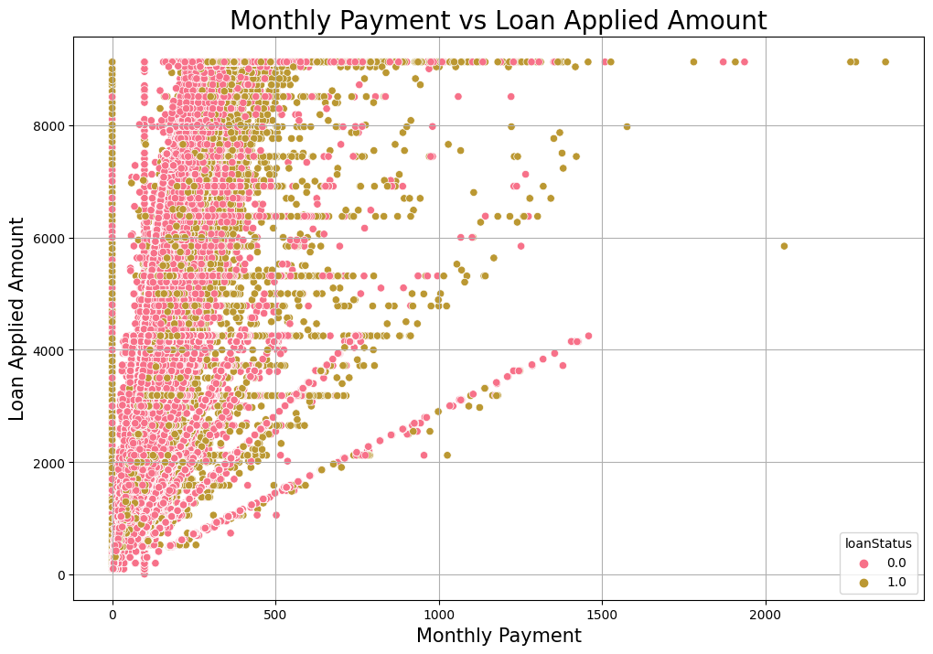
we can see here that as monthly payment increase with Lan applied amount obviously if you want a bigger loan you should pay more

Slide 20
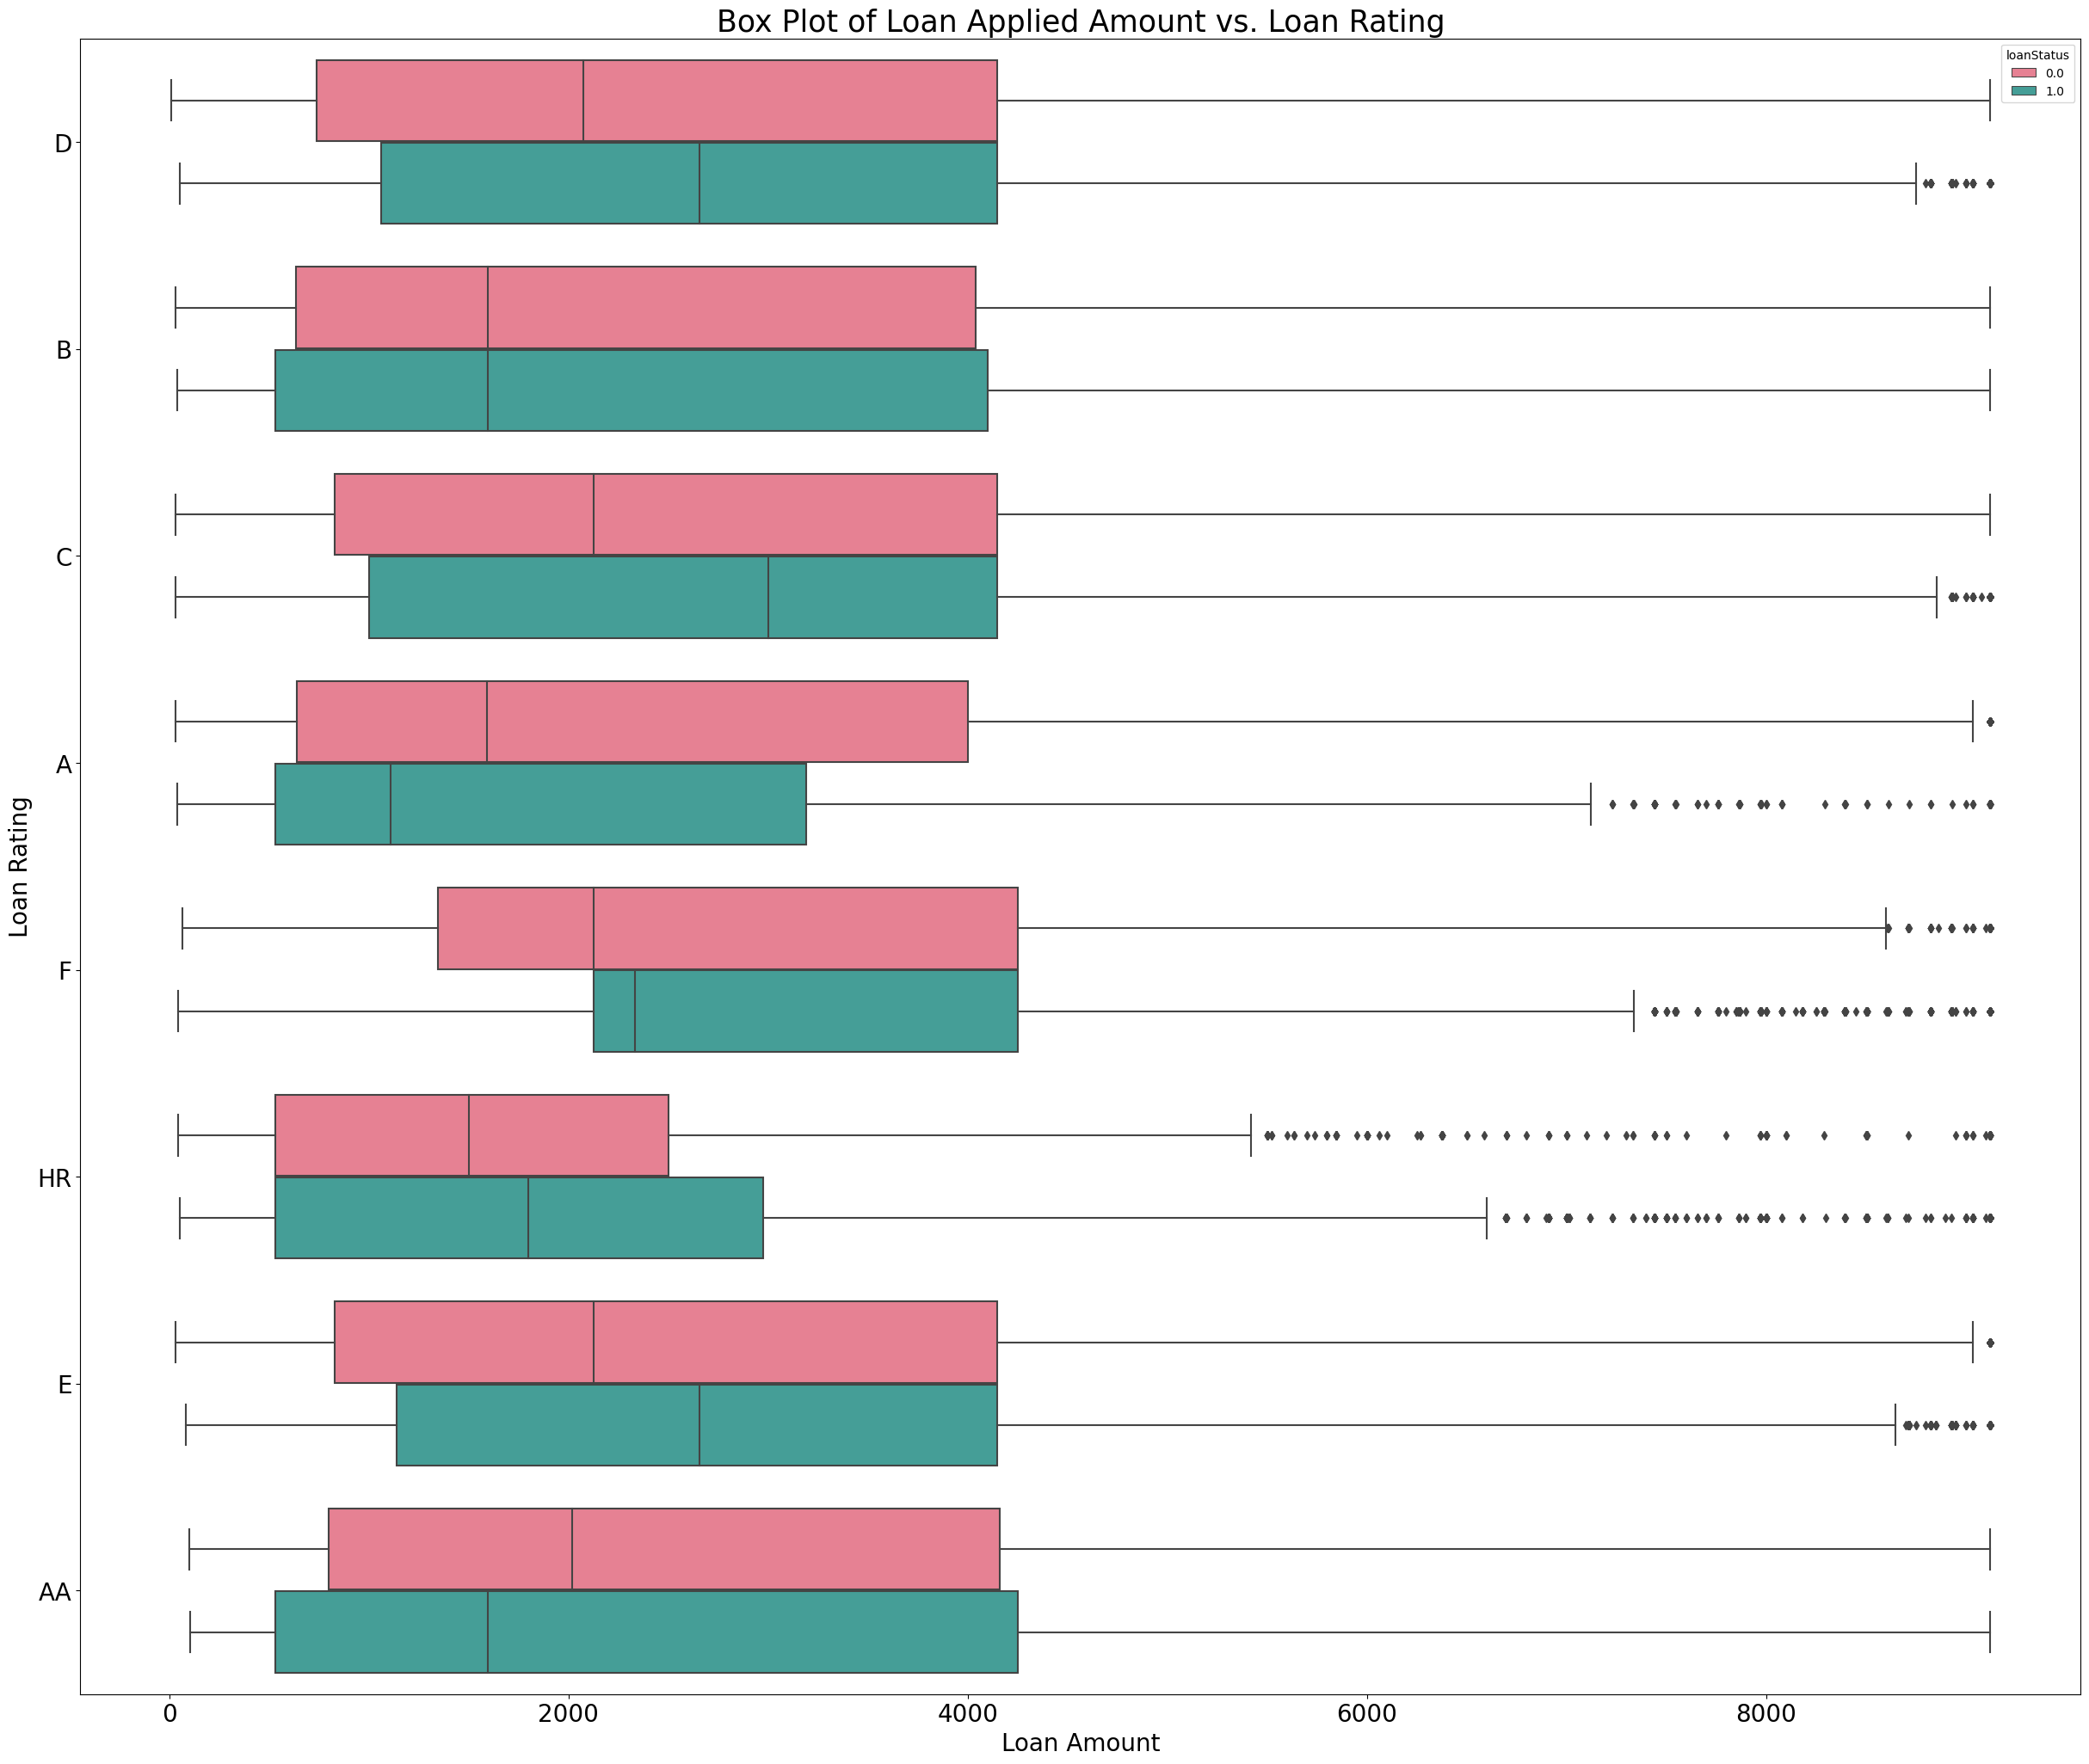
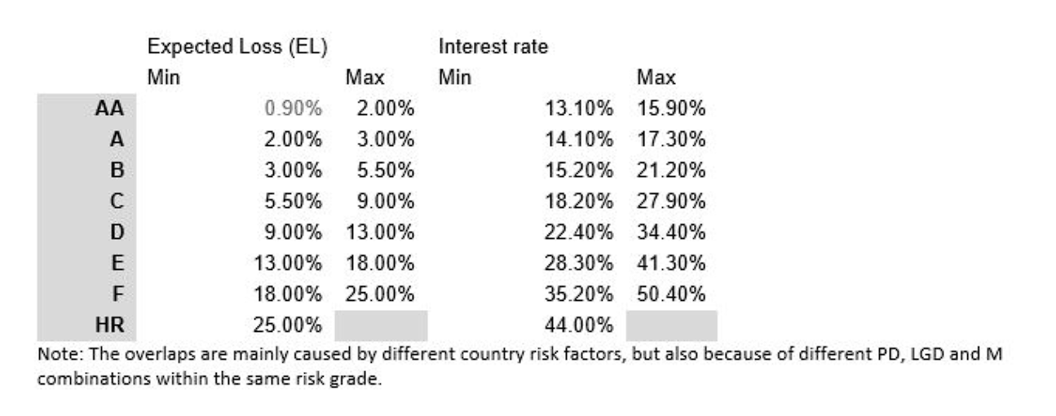

Slide 21
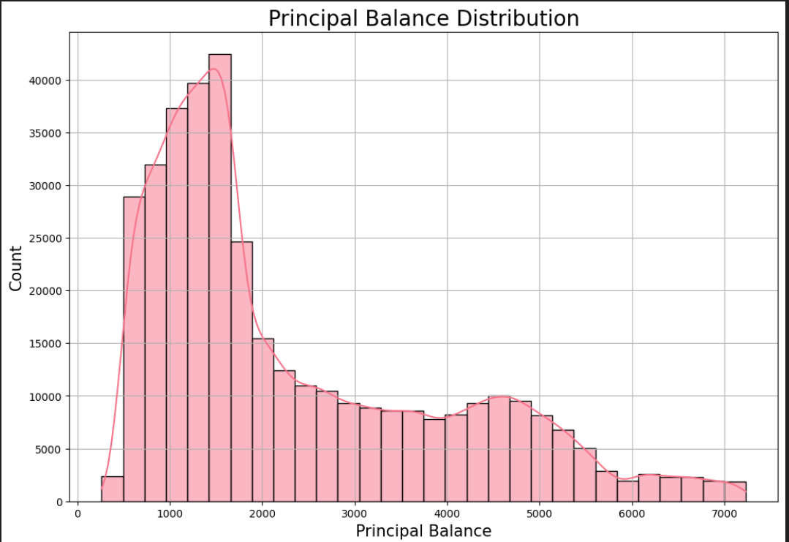
The principal balance in loans refers to the amount of money you originally borrowed, excluding any interest or fees that have been added on since the loan's inception. It represents the initial debt that you are obligated to repay to the lender

Slide 22
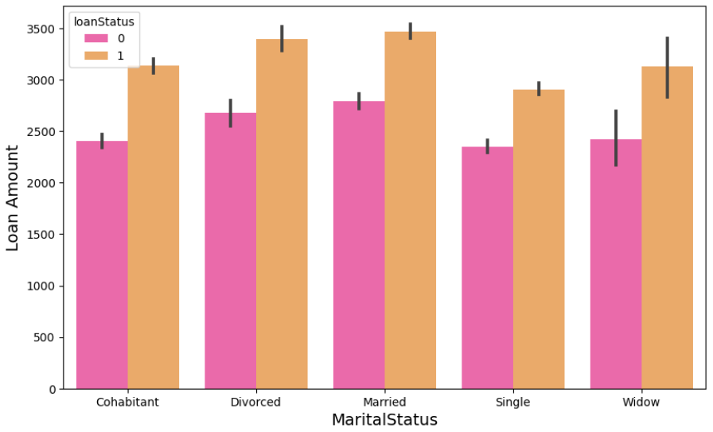

Slide 23
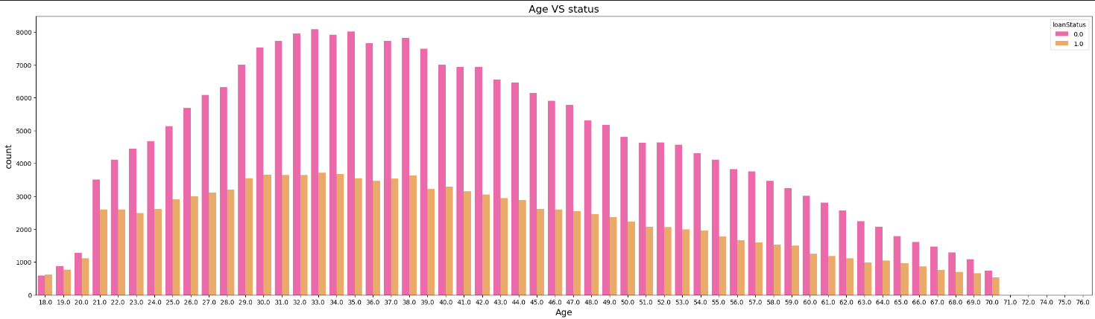
Normal distribution as being in age 25-45 is high probably you will apply to a loan (starting a new business or something like that)

Slide 24
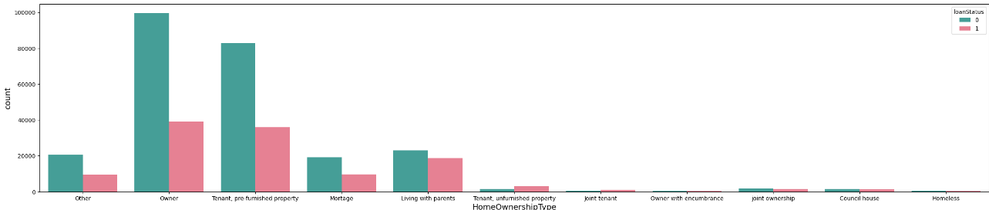
being an owner of house increases your chance of getting the loan also the people owning or tenanting an house are more likely to apply to a loan

Slide 25
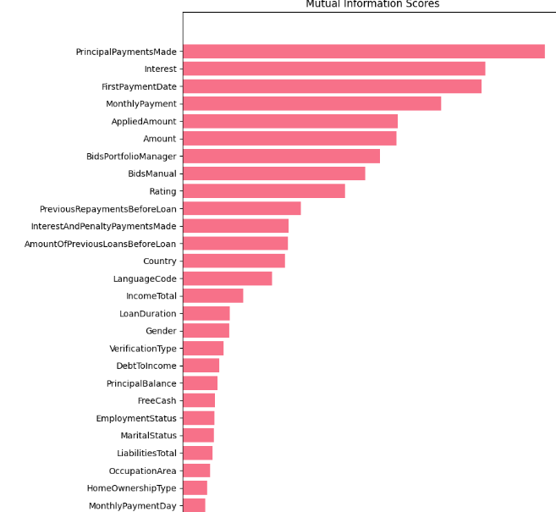
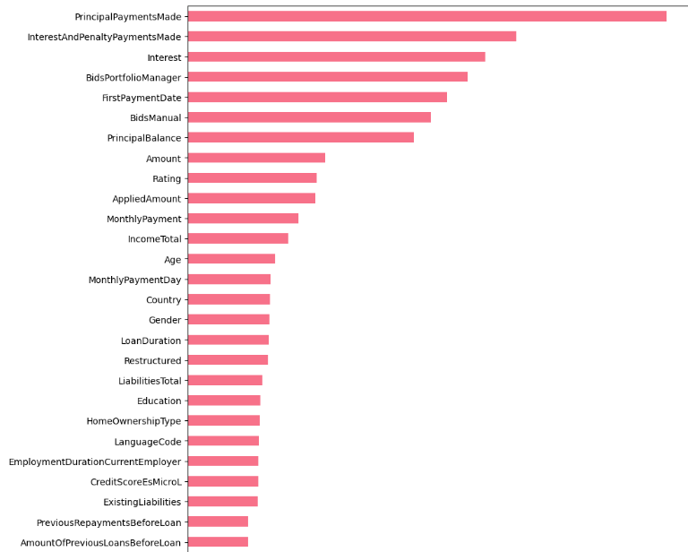
Mutual information
Feature Importance

Slide 26
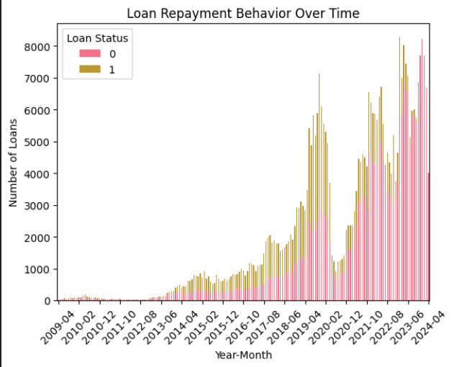
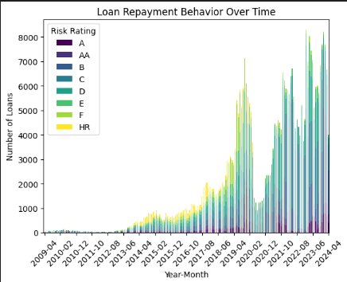
Loan amounts are increasing over time

Slide 27
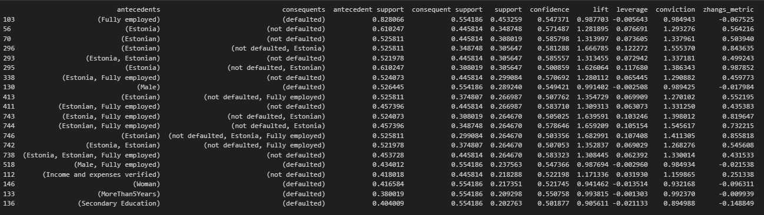
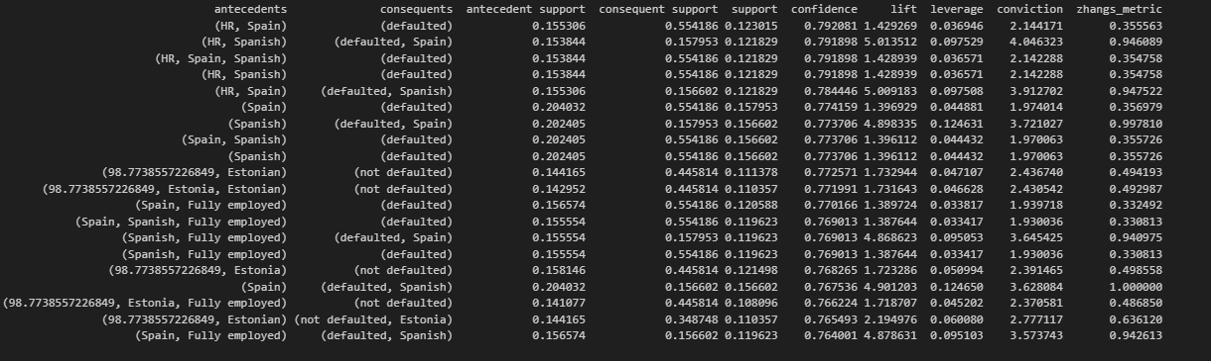
Sorted by support
Sorted by confidence

Slide 28
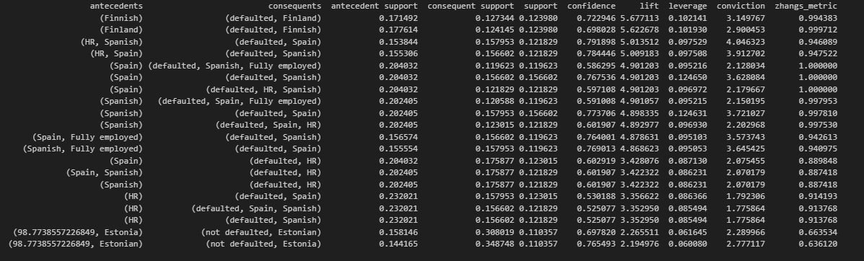
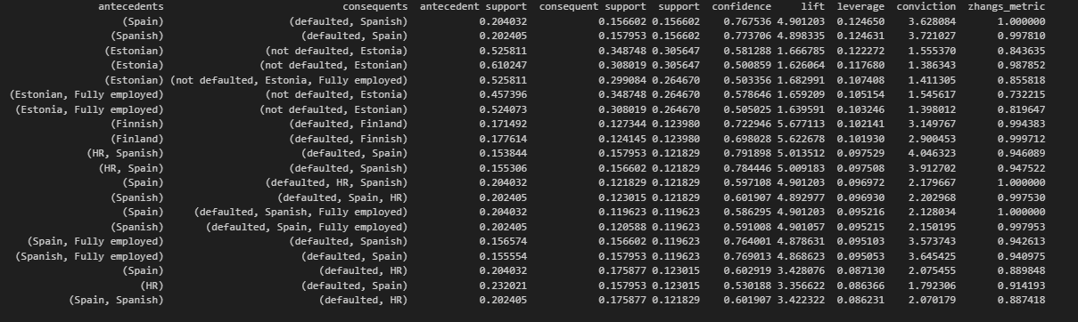
Sorted by lift
Sorted by leverage

Slide 29
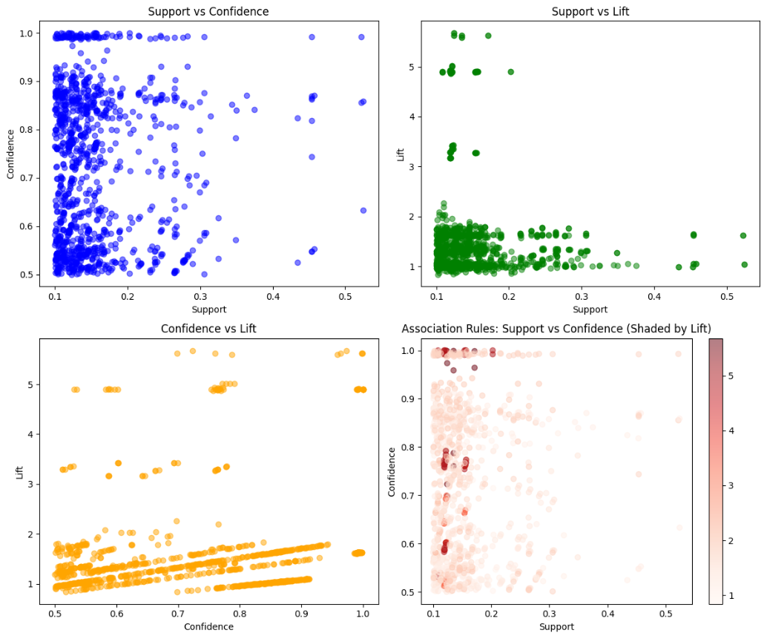

Slide 30
Model Training and Evaluation
04

Slide 31
model | dataset | Accuracy |  | Precision |  | Recall |  | F1
Logistic Regression | Train | 0.814 |  | 0.810 |  | 0.814 |  | 0.819
 | Test | 0.816 | 81.62 | 0.812 |  | 0.816 |  | 0.817
Decision Tree | Train | 0.832 |  | 0.835 |  | 0.832 |  | 0.822
 | Test | 0.830 |  | 0.833 |  | 0.830 |  | 0.891
Random Forest | Train | 0.815 |  | 0.824 |  | 0.815 |  | 0.799
 | Test | 0.817 |  | 0.826 |  | 0.817 |  | 0.801
Linear SVC | Train | 0.813 |  | 0.809 |  | 0.813 |  | 0.806
 | Test | 0.815 |  | 0.812 |  | 0.815 |  | 0.808
Gradient Boosted Tree | Train | 0.892 |  | 0.895 |  | 0.892 |  | 0.888
 | Test | 0.891 |  | 0.894 |  | 0.891 |  | 0.887
KNN (Map-Reduce) 1000 | Test | 0.66 | 0.66 sklearn

Slide 32
Unsuccessful Trials and Furure Work
05

Slide 33

Training with One Hot encoding
Handling large data sizes with KNN
Add more models
Implement naïve bayes with mapReduce
Add more visualizations
Scale KNN algorithm

Slide 34
Deploy on Azure
06

Slide 35
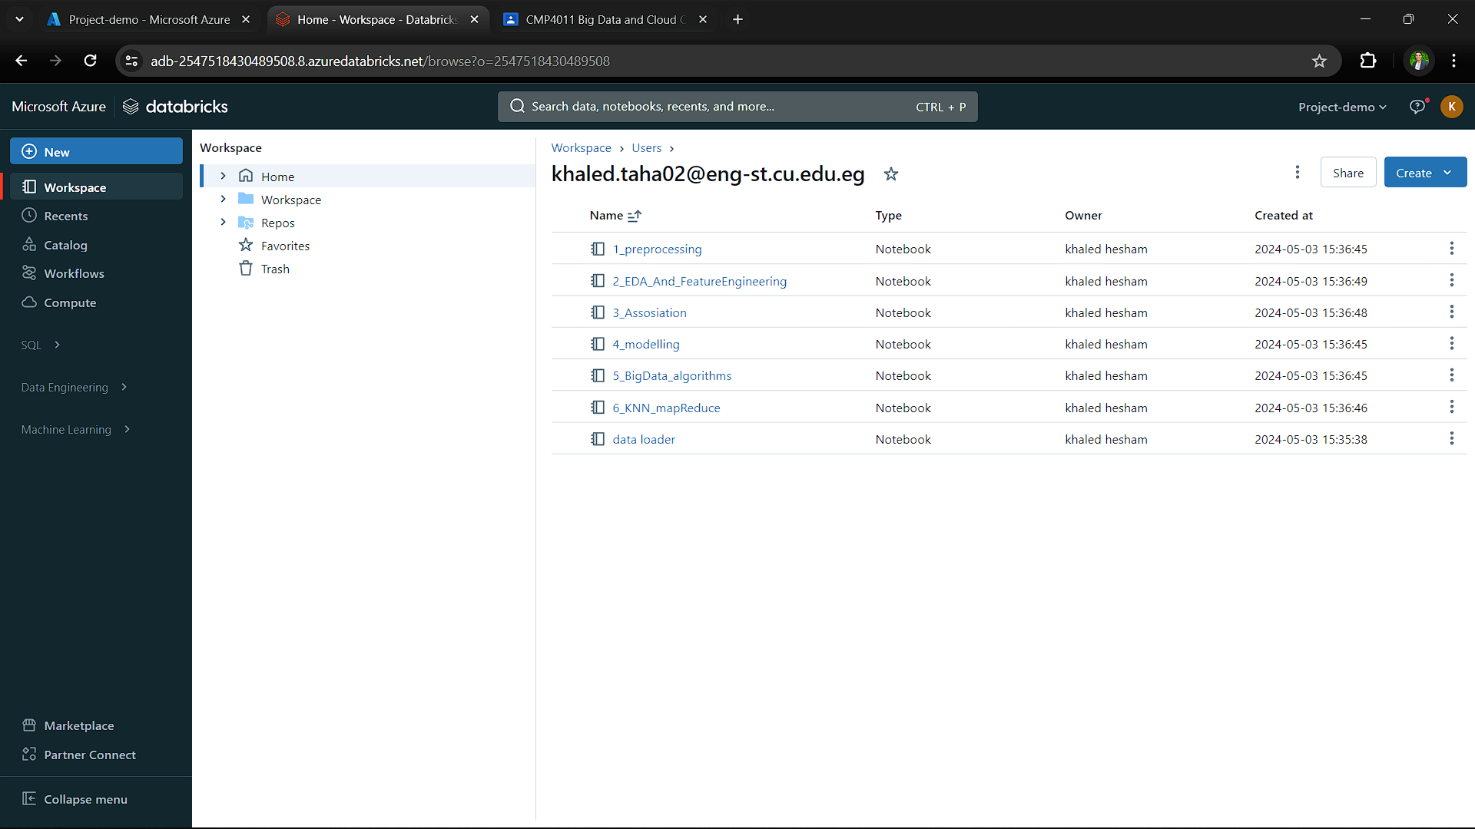

Slide 36
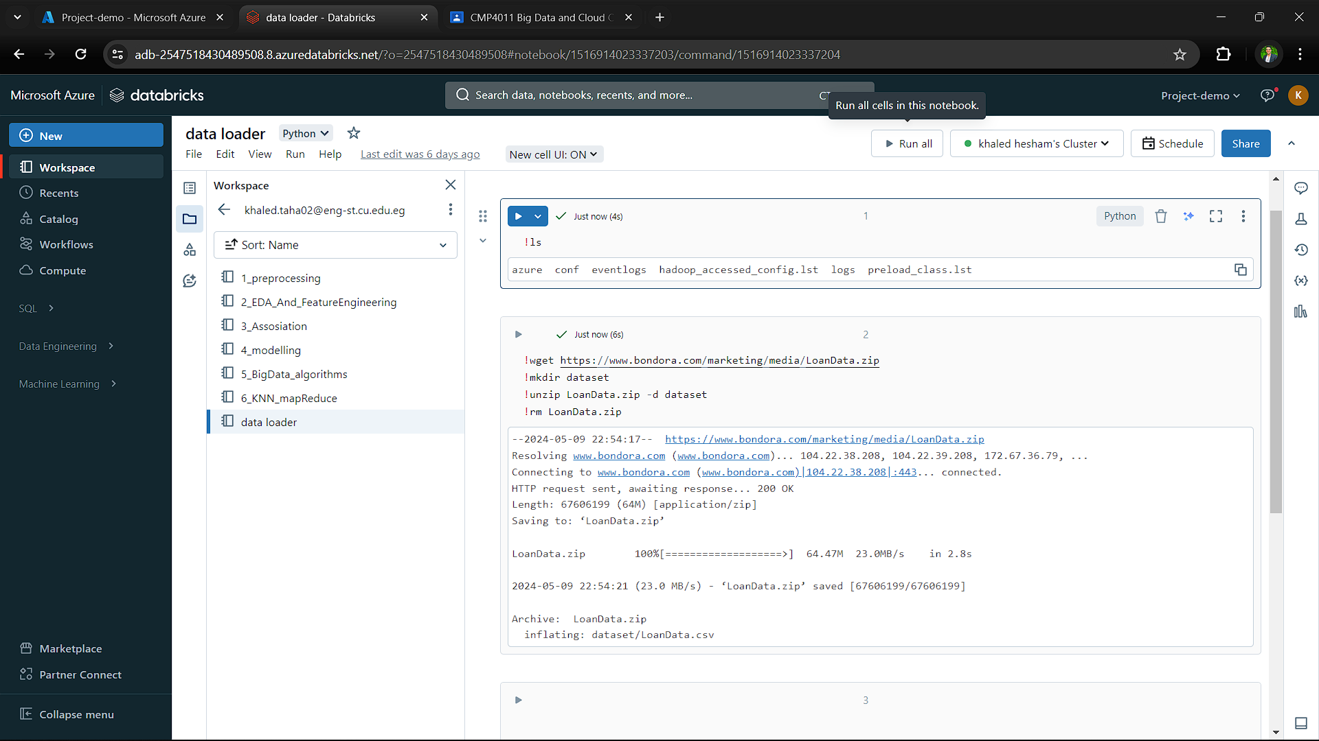
Deploy on Azure
06

Slide 37
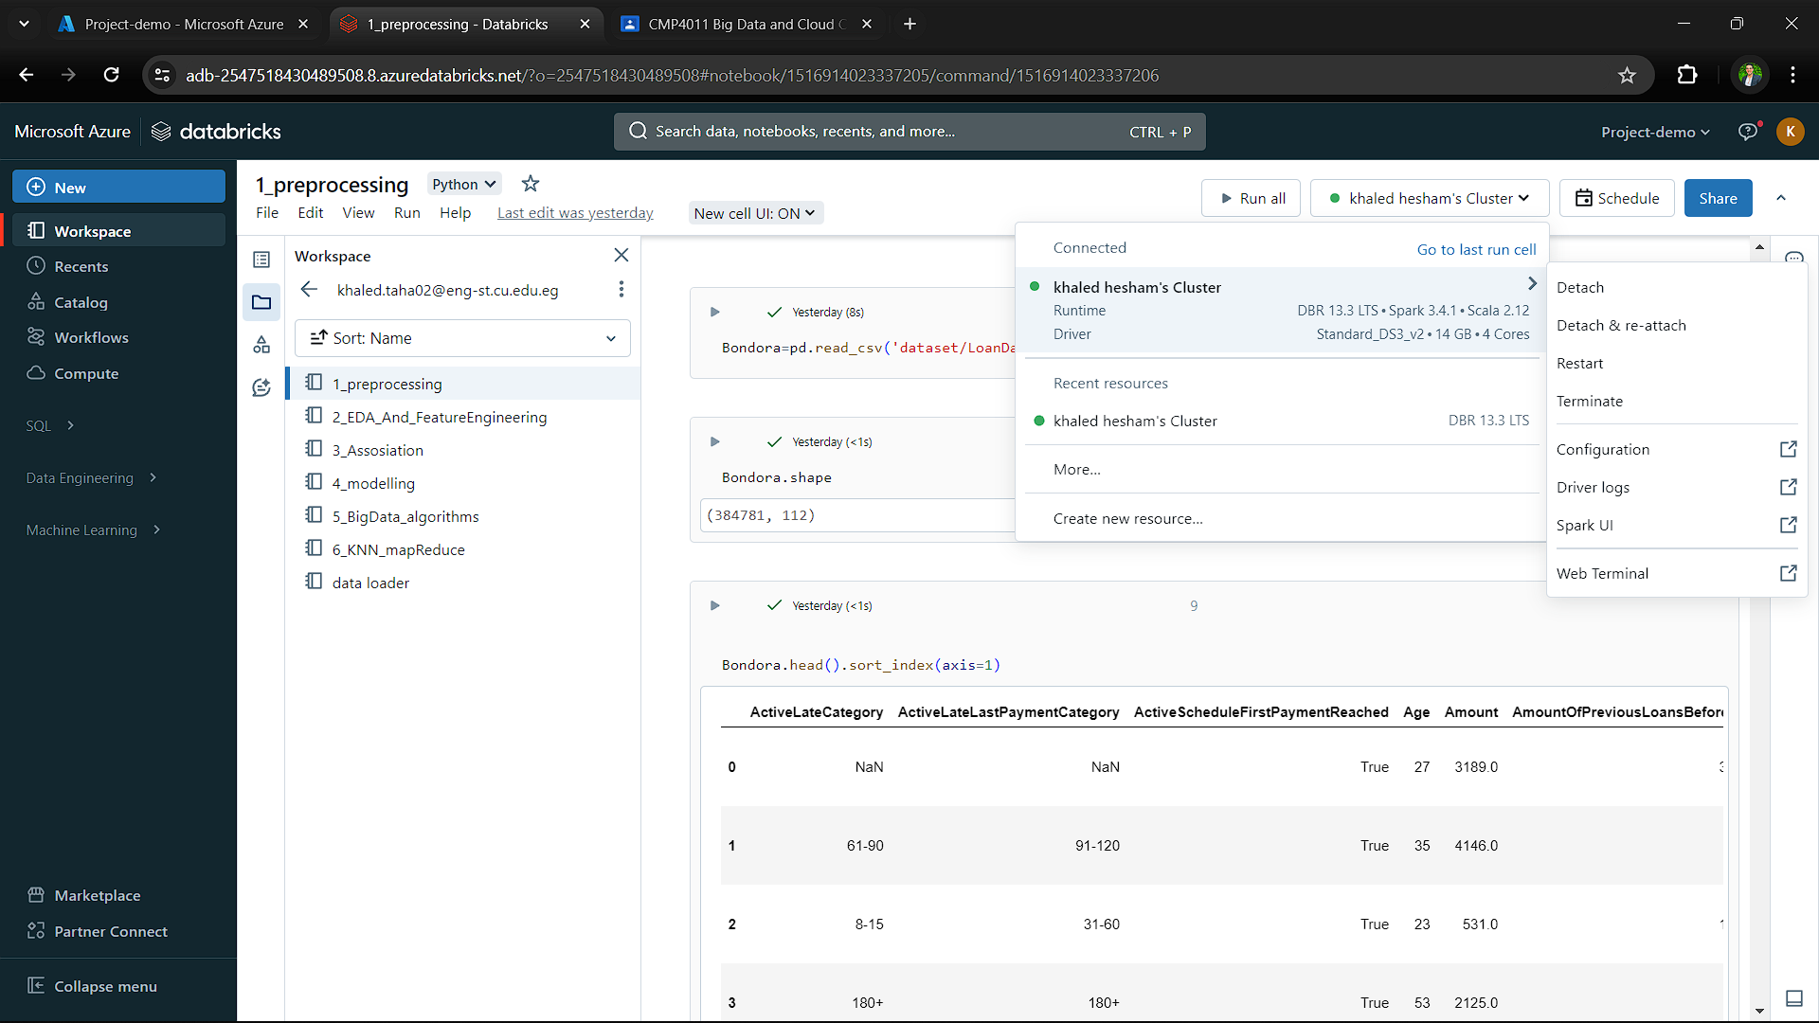
Deploy on Azure
06

Slide 38
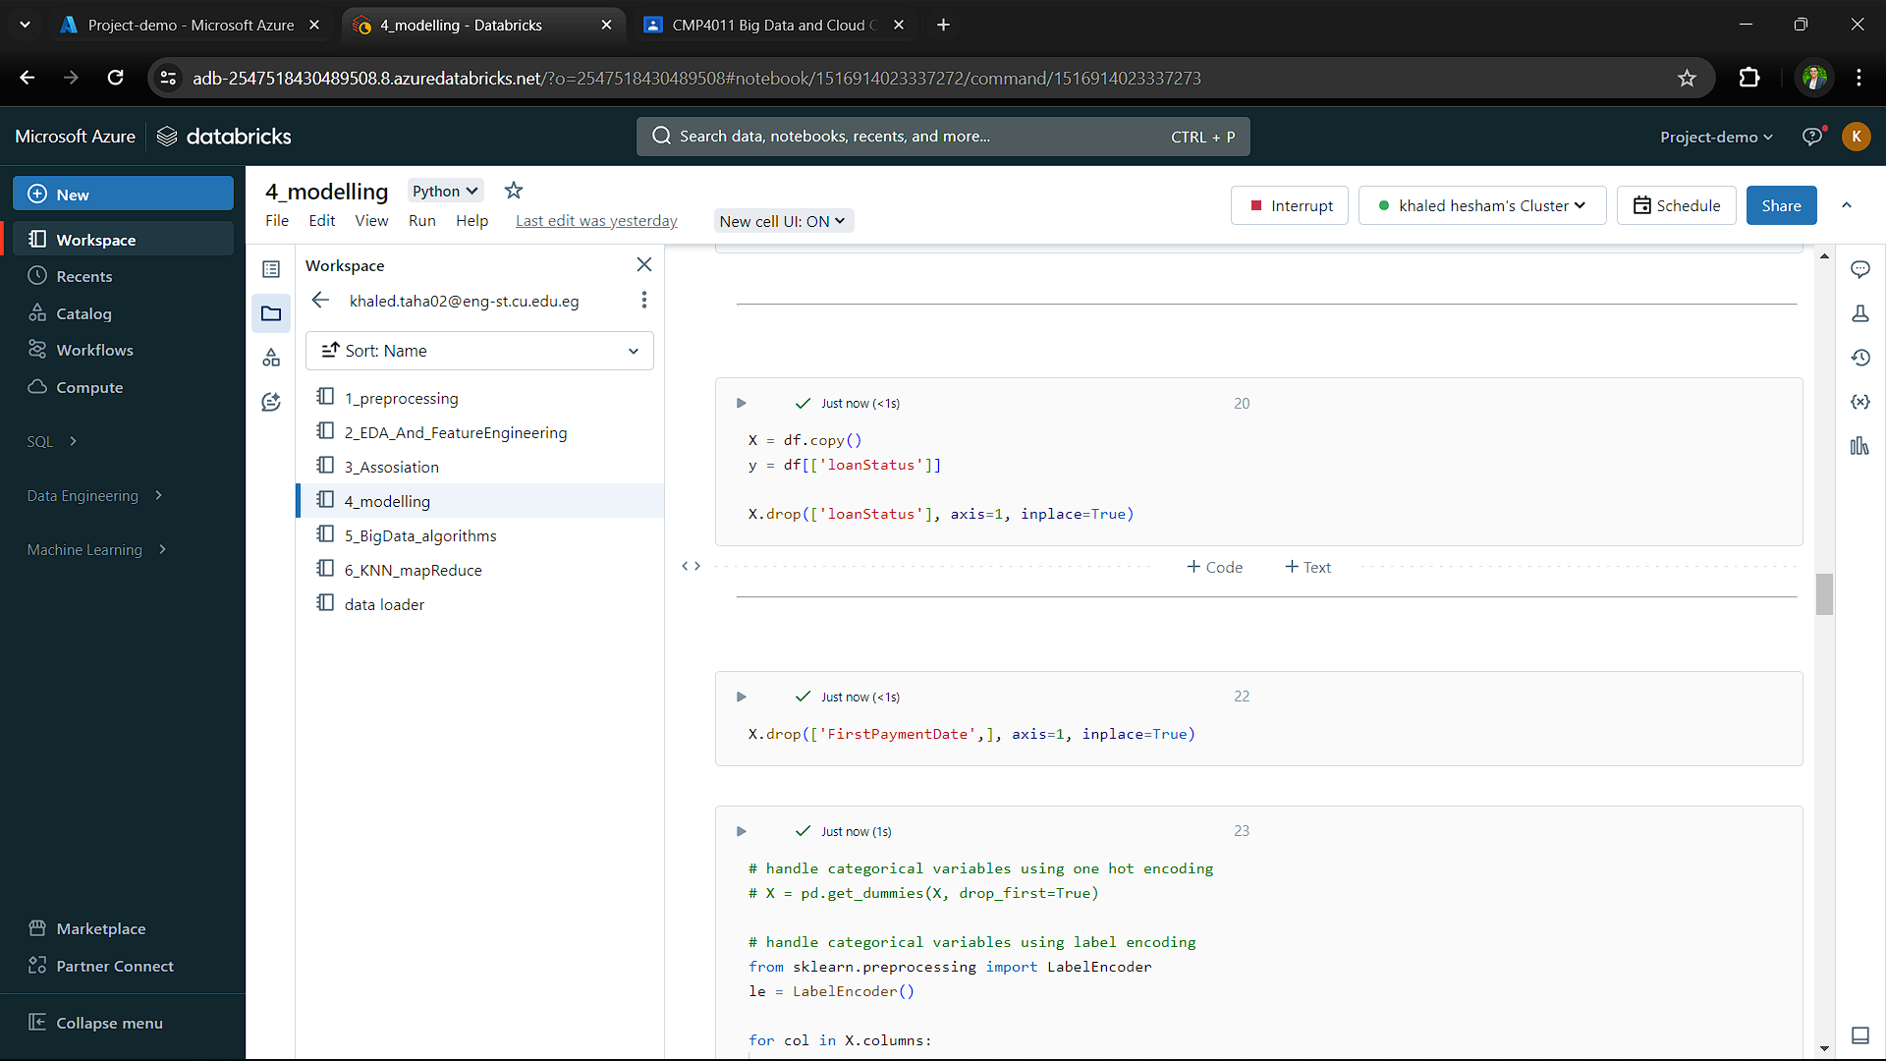
Deploy on Azure
06

Slide 39
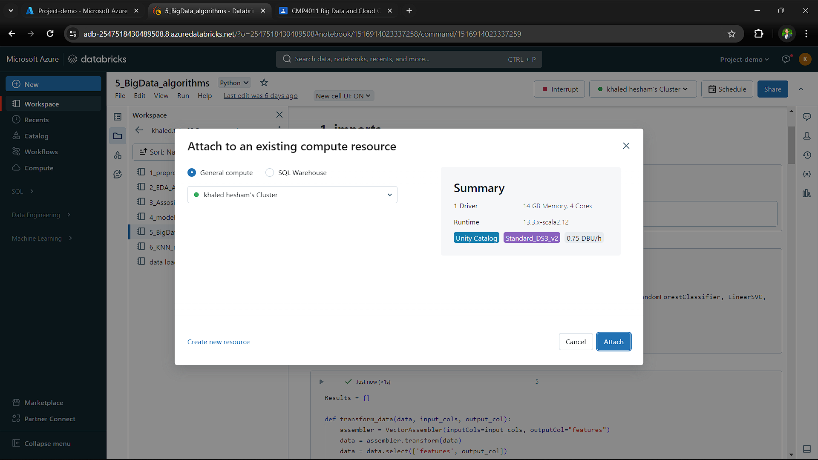
Deploy on Azure
06

Slide 40
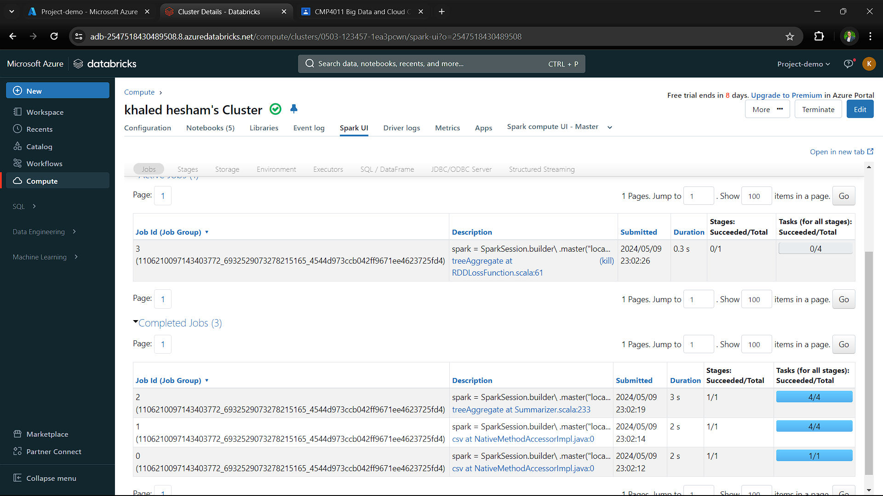
Deploy on Azure
06

Slide 41
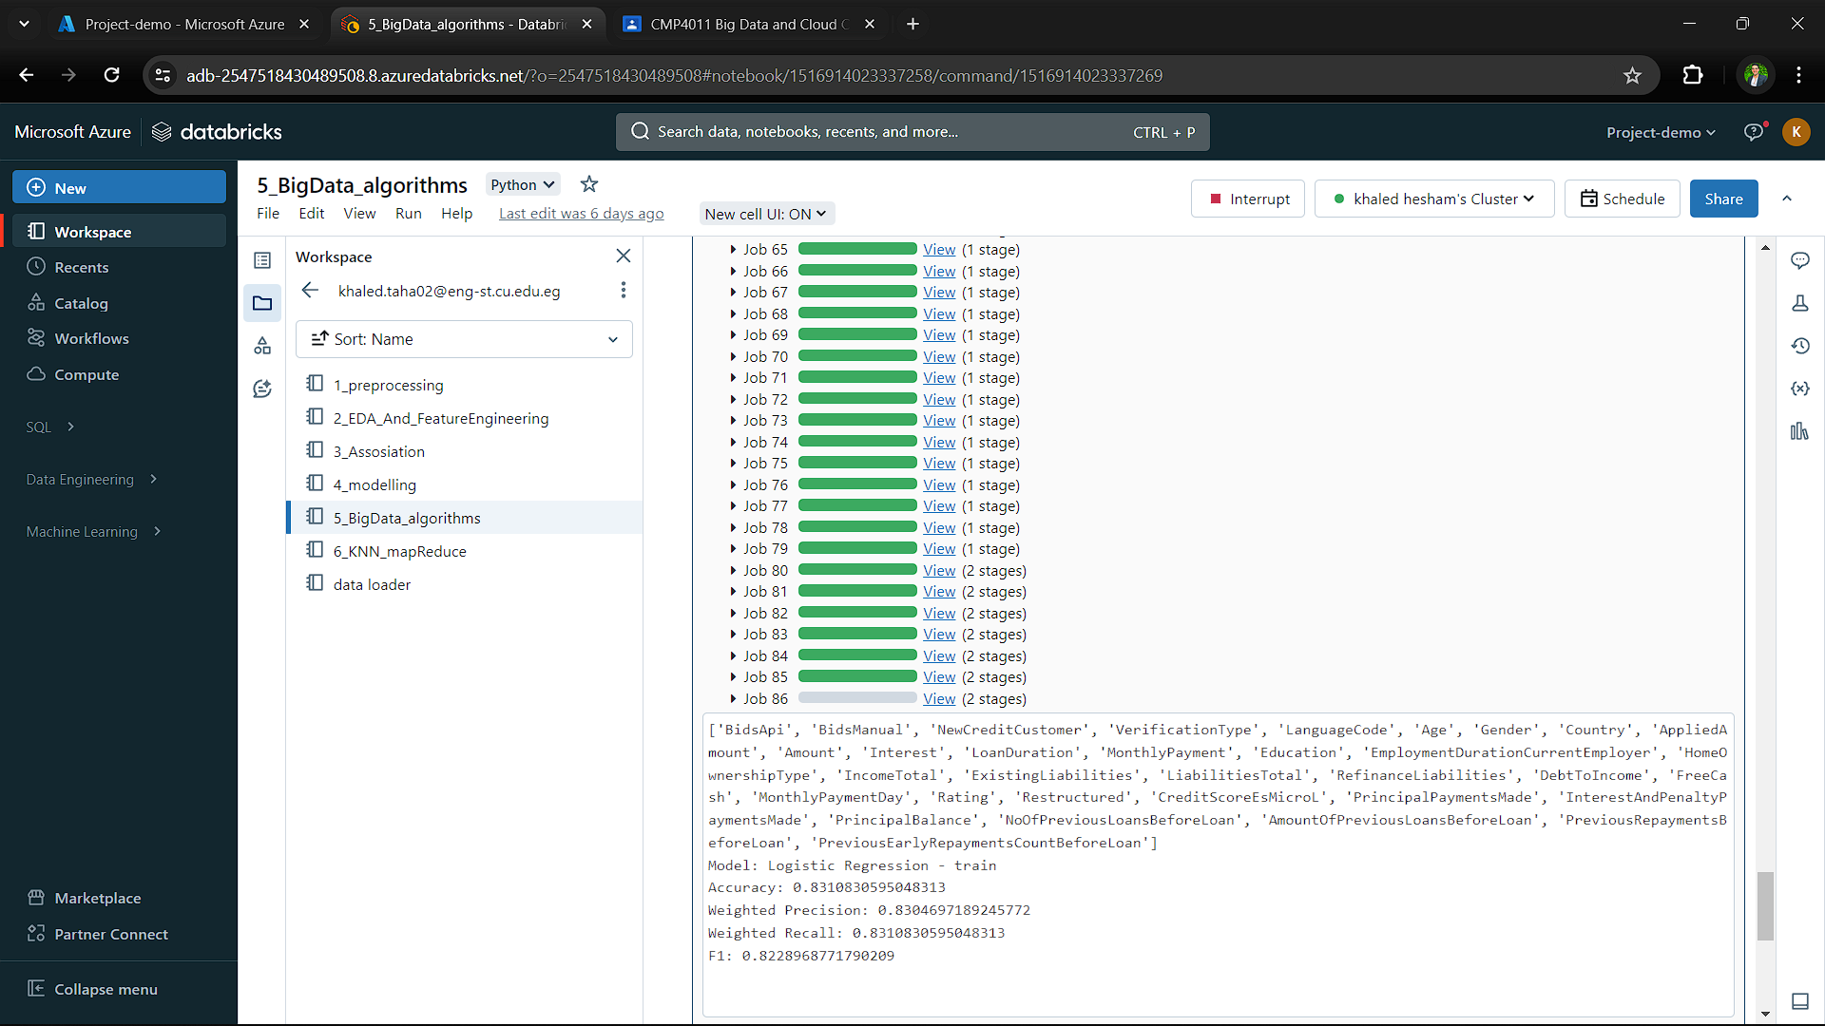
Deploy on Azure
06

Slide 42
THANK YOU

